Slide 1

Bangalore house prices
By Rakshith, Pradeep, Abhishek & Samad

Slide 2
About the dataset
What are the things that a potential home buyer considers before purchasing a house? The location, the size of the property, vicinity to offices, schools, parks, restaurants, hospitals or the stereotypical white picket fence? What about the most important factor — the price?
Now with the lingering impact of demonetization, the enforcement of the Real Estate (Regulation and Development) Act (RERA), and the lack of trust in property developers in the city, housing units sold across India in 2017 dropped by 7 percent. In fact, the property prices in Bengaluru fell by almost 5 percent in the second half of 2017, said a study published by property consultancy Knight Frank. For example, for a potential homeowner, over 9,000 apartment projects and flats for sale are available in the range of ₹42-52 lakh, followed by over 7,100 apartments that are in the ₹52-62 lakh budget segment, says a report by property website Makaan. According to the study, there are over 5,000 projects in the ₹15-25 lakh budget segment followed by those in the ₹34-43 lakh budget category.
Buying a home, especially in a city like Bengaluru, is a tricky choice. While the major factors are usually the same for all metros, there are others to be considered for the Silicon Valley of India. With its help millennial crowd, vibrant culture, great climate and a slew of job opportunities, it is difficult to ascertain the price of a house in Bengaluru.

Slide 3
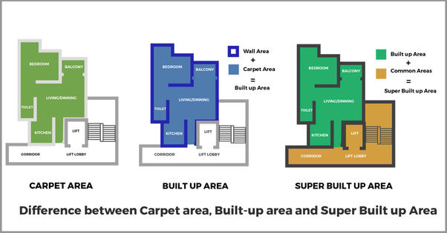

Features:
Area type:
Carpet Area:
An area that can be covered by carpet or net usable area is called Carpet area.
Built Up Area:
The Built-Up Area of a premise is measured from the external perimeter wall surfaces.
Super Built Up Area:
Super Built Up Area is nothing but the combination of built up area and common areas

Slide 4
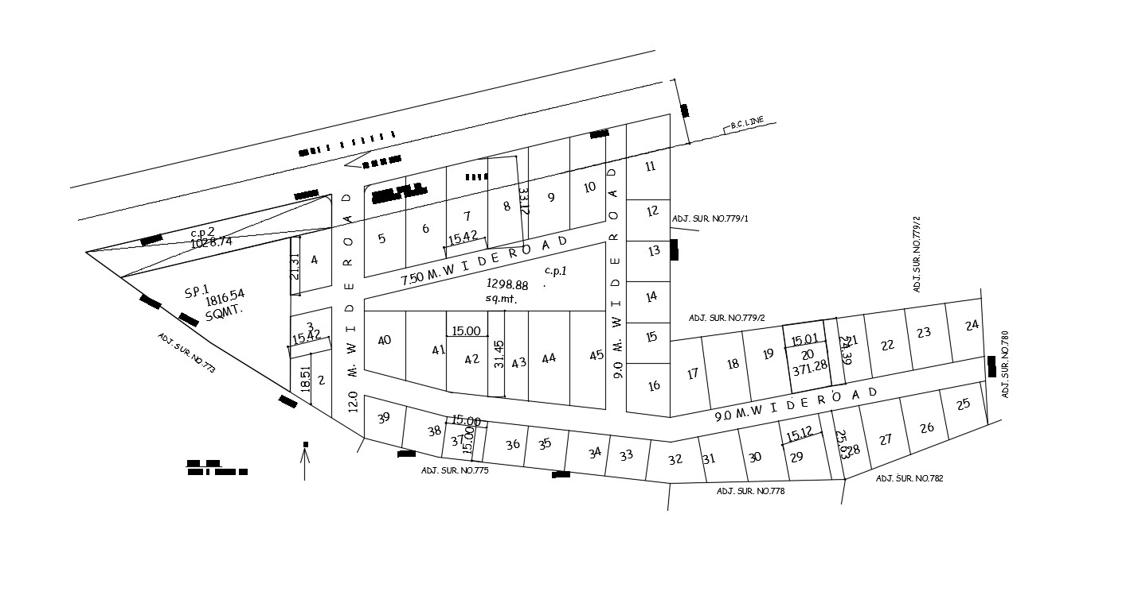
Plot Area:
The area which is surrounded by a boundary line (fencing) is called as Plot Area.
Plot Area

Slide 5
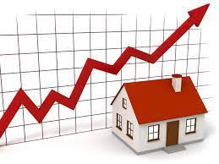
Availability: The availability of the houses at their locations and shows when it could be accessed.
Location: Location gives the exact area location around Bangalore.
Size: Size shows the number of bedrooms in BHK.
Society: The locality name of the houses.
Total sqft: The dimension of the houses in square feet.
Bath: Number of bathrooms availability.
Balcony: Number of balconies availability.
Price: Houses price range in lakhs.

Slide 6
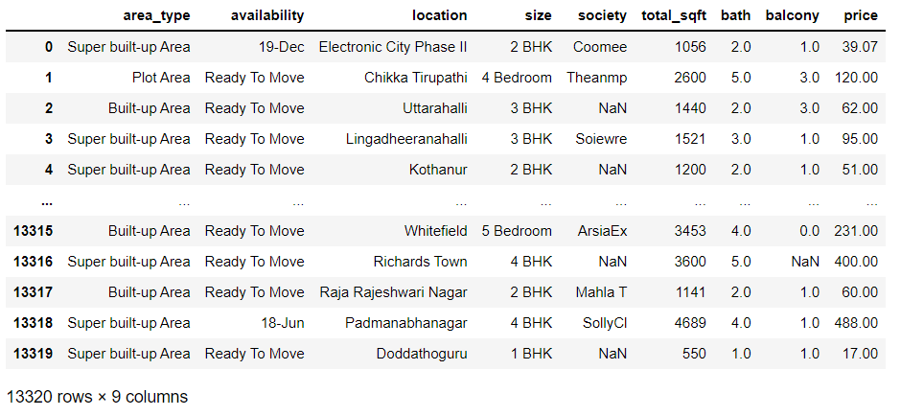
BANGALORE_HOUSE_PRICE DATA

Slide 7
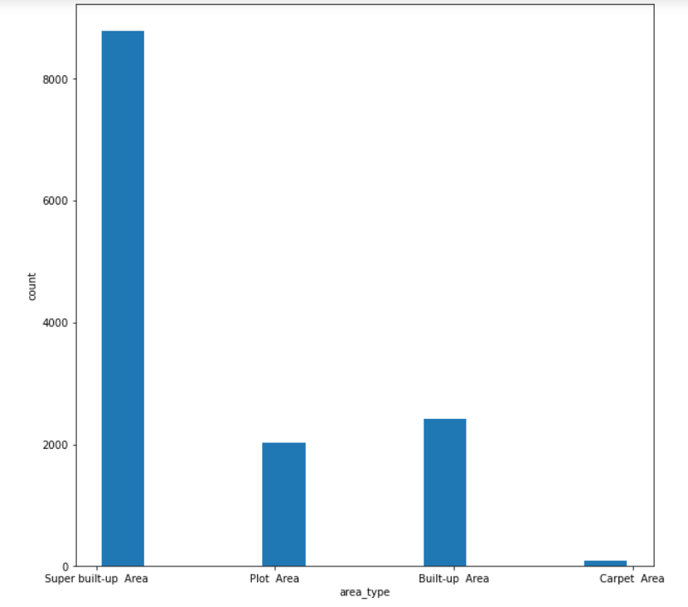
Bar plot of Area_type VS counts
So the above graph represents the count of each area_type.
As we can see that the “Super built up Area” has the maximum counts
That mean max of house are provided as “Super built up Area” .

Slide 8
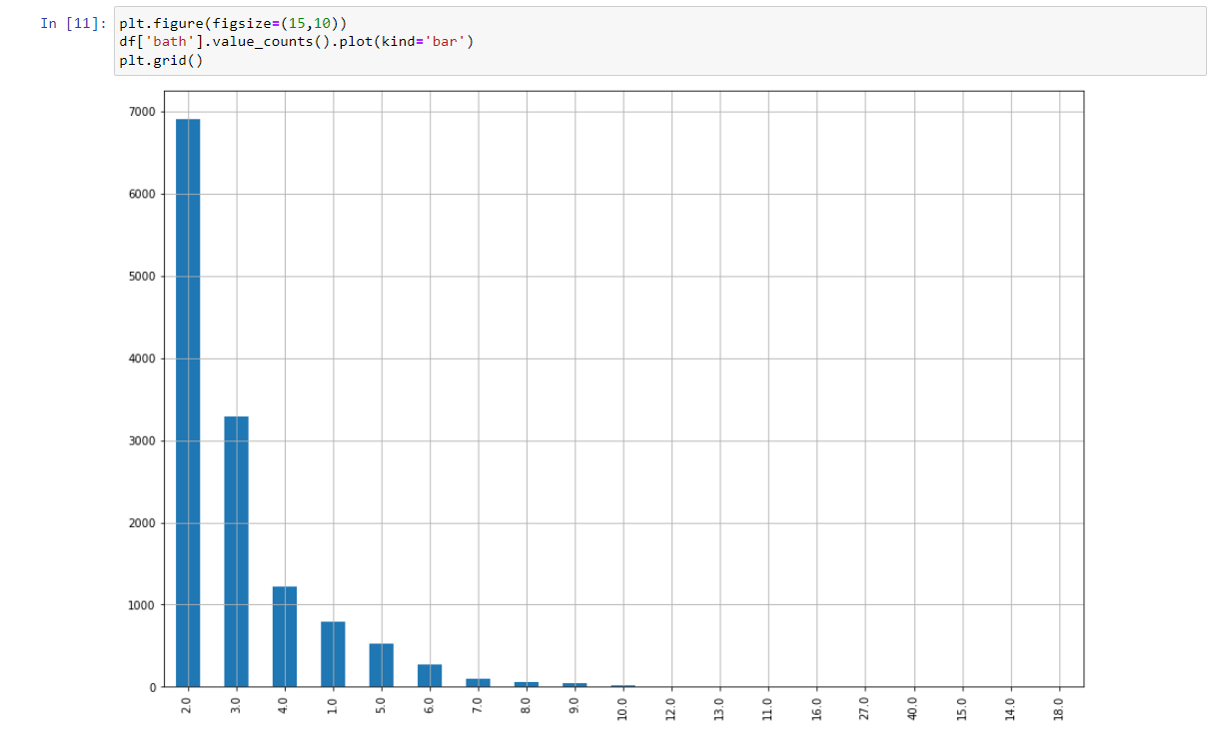
Bar plot of Number of Bathroom VS Value_counts
The above graph represents the Number of Bathroom counts,
We can conclude that maximum of the house for sale are having a average of 2 Bathrooms

Slide 9
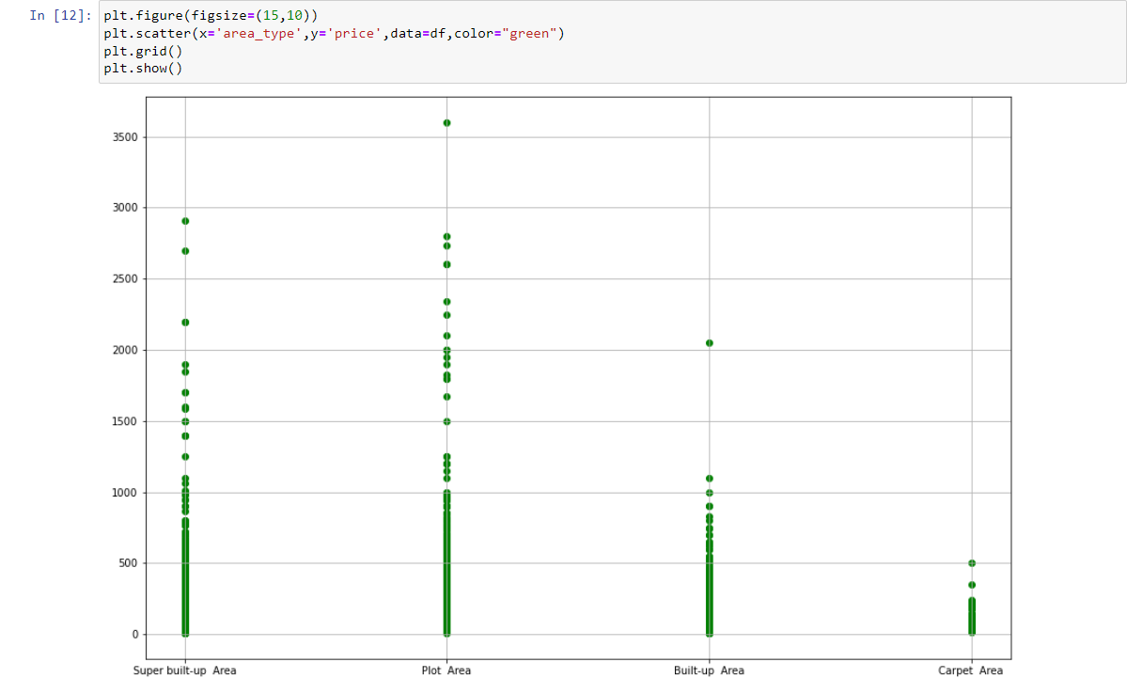
Scatter plot of Area_type VS Price (lakhs)
The above Graph represents the area_type with respect to price in lakhs
As we can see that the Carpet Area has the Min Cost as compared to others.

Slide 10
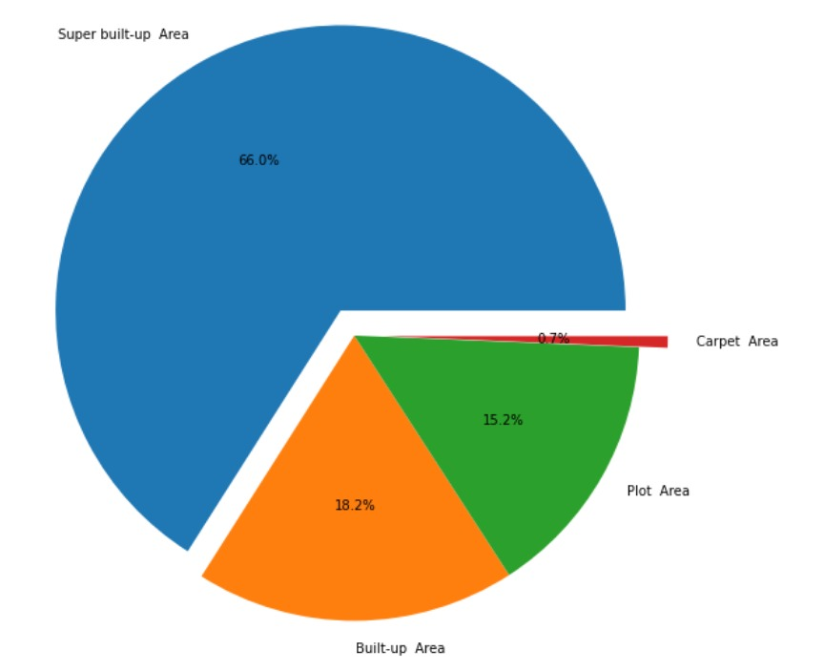
Pie chart of Area_type VS Value_counts in percentage
The above chart gives the value counts of areas in the percentage and we can conclude that Super built up area is Max compared to other areas.

Slide 11
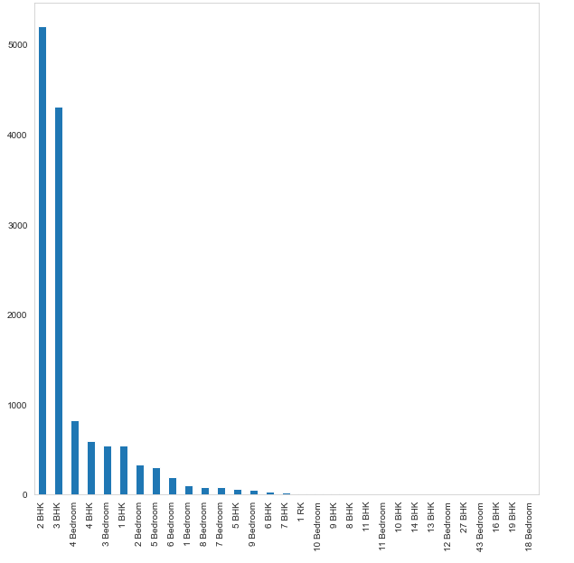
Bar plot of BHK VS value_counts
The above graph shows the value counts of Bedrooms and we can say that 2BHK gets the highest score. But here you can see that they are termed as BHK ,RK and Bedroom which are same and converted to BHK in the future.

Slide 12
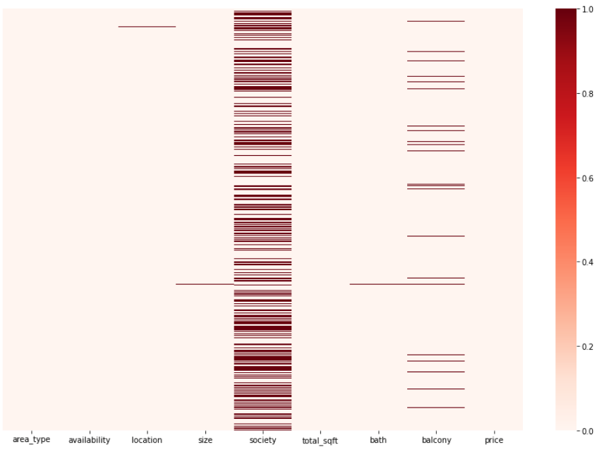
Heatmap
In the above heatmap, we can detect that ‘location’, ’size’, ’society’, ‘bath’, ‘balcony’. But among all ‘society’ has the highest null values which has to be treated.

Slide 13
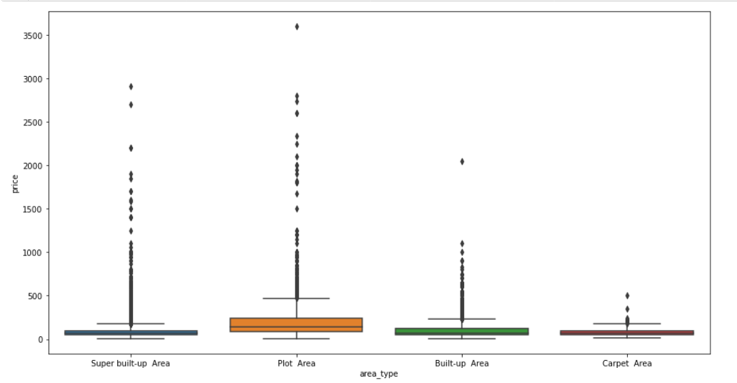
Box plot of Area_type VS Price
The above figure shows the outliers of ‘area_type’ with respect to ‘price’ and we can say that ‘super built up area’ and ‘plot area’ has the maximum outliers compare with others.

Slide 14
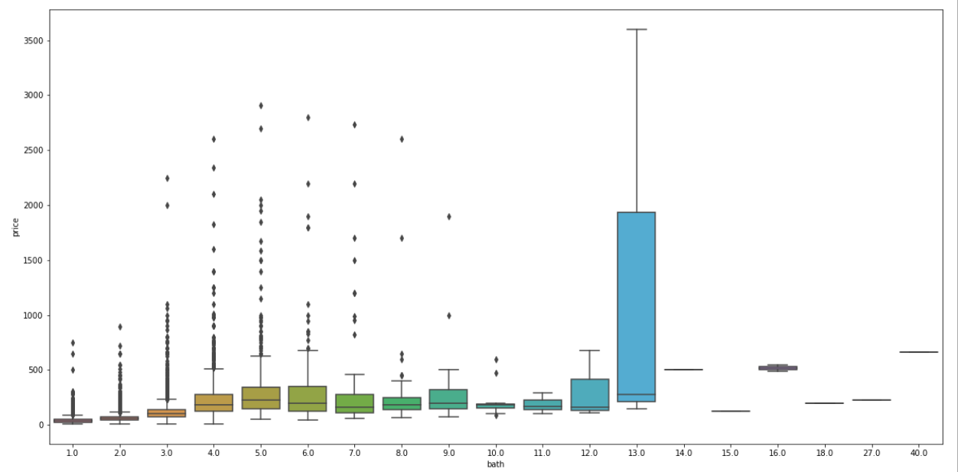
Box plot of bath VS price
The above box plot shows that the maximum outliers ranges from ‘3’ to ‘8’ “bath” with respect to “price”.

Slide 15
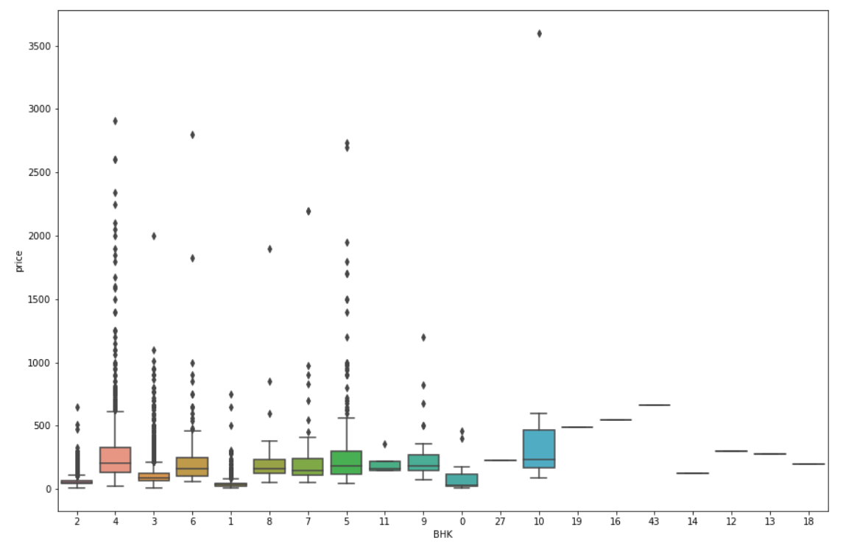
Box plot of BHK VS price
The above box plot shows that from ‘2’ to ‘10’ BHK we are having the maximum outliers with respect to price.

Slide 16
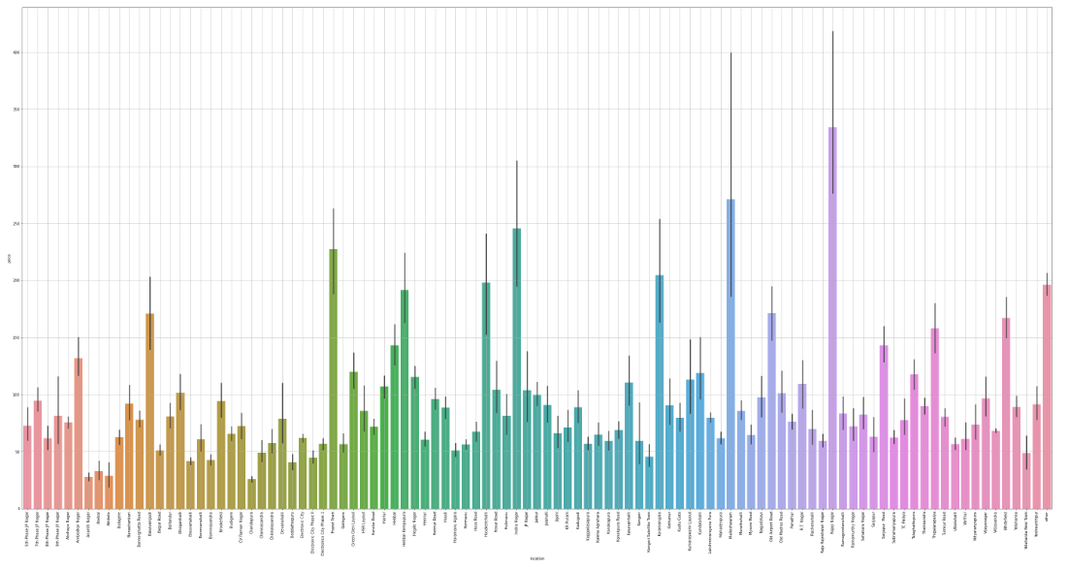
Bar plot of location VS Price
The above bar plot shows us the value counts of each location with respect to price.

Slide 17
After treating all the outliers, we are going for the “Model Building” part.

Slide 18
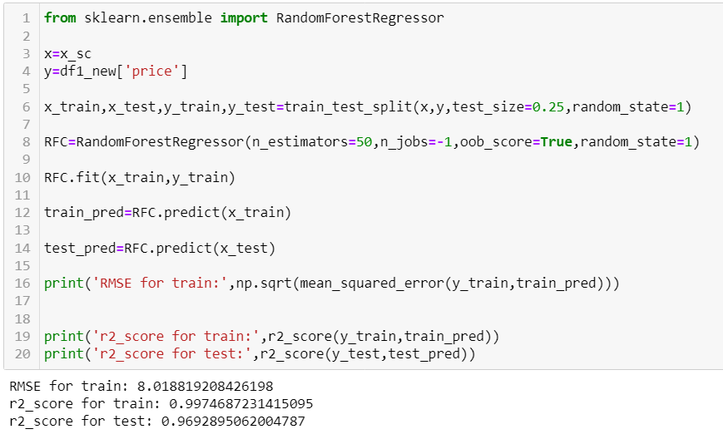
Random Forest

Slide 19
From building model using “Random Forest” we got the best “RMSE”=8.01 and “r2_score for train”=99.7%.So we can conclude that our “House Price Prediction” is very much accurate as per predicted.

Slide 20
Thank You

